Slide 1
College: Worth it?
CS 336 Semester Database Project
by Xing Xiang & Peiqing Lian

Slide 2
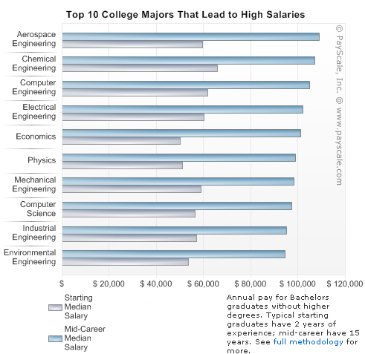
The
Choices of
Best-paid
Graduates
Some Highlights:
In general, engineering schools produced the best starting salaries, and represented eight out of the top 10 schools in starting salary.
Majors matter. Quantitative-oriented degrees – like engineering, science, mathematics and economics — filled most of the top 20 slots in both highest starting median salaries and highest mid-career median salaries.

Slide 3
So…the Motivation
With more and more prospective college freshmen, one question coming into attention—will I make money if I go to…..
As we can see, students and parents will need more statistics to help them make a wise decisions.
That is how we could help…….

Slide 4
The Purpose
Make it easier when researching colleges’ data and information.
Present top colleges and hot majors based on annual salary earned by graduates.
Help them make decisions

Slide 5
How it works…
Users can choose what they want to search and what means importantly to them.
Homepage users search results by selecting what colleges, which city, and expected tuition fee.
It will give users a feedback by clicking submit
If irrelevant information was selected, it will pop up a error page
If relevant, users will see corresponding queries

Slide 6
Program URL
http//98.126.65.243/
data url(selected first 1000+ tuples)
https://inventory.data.gov/dataset/5745c647-df74-451e-a62f-b02920daed31/resource/c95fae96-ce4a-459c-a935-ba2a37767ac9

Slide 7
